Slide 1
Lab 8

Slide 2
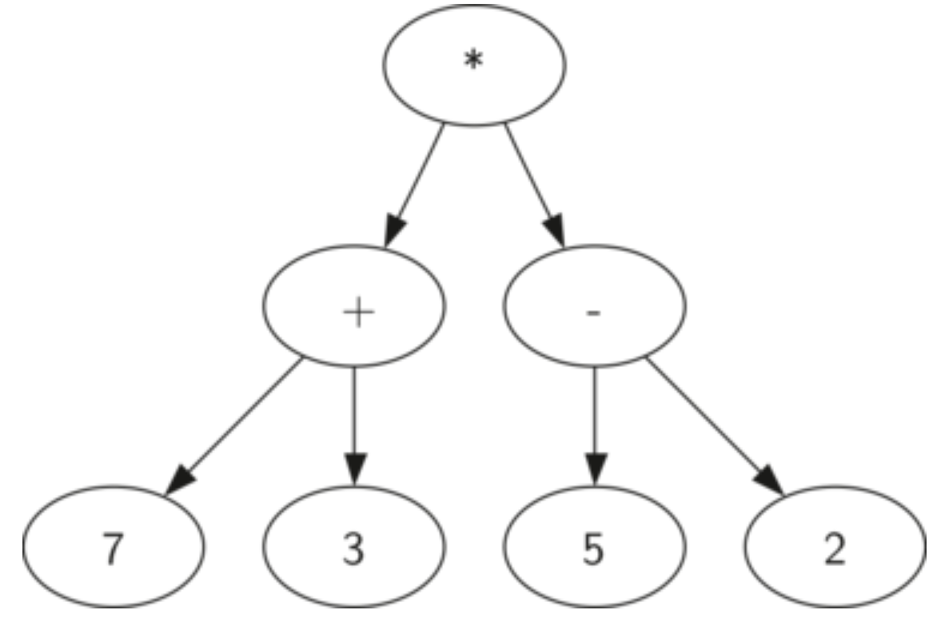
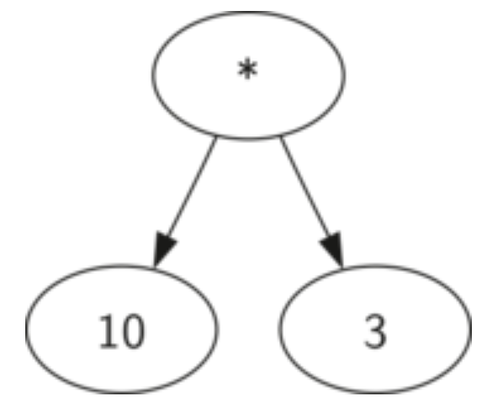
Parse Tree
We can represent a mathematical expression such as ((7+3)∗(5−2)) as a
parse tree (binary tree). Below are two such trees:
A parse tree for (10*3)
A parse Tree for ((7+3)∗(5−2))

Slide 3
Assignment
Given the root node of a parse tree representing a mathematical expression, write a Python function named evaluate(node) that computes and returns the result of that expression. Assume that the expression only contains the operators +, -, *, and /, and integer/floating-point numbers as operands.
You can start with the example code provided in the next slide. Implement the ’evaluate()’ method and submit the entire script in iCollege.

Slide 4
Example code
class Node: def __init__(self, value, left=None, right=None): self.value = value self.left = left self.right = right # Construct the parse tree for ((7 + 3) * (5 - 2)) root = Node('*') root.left = Node('+') root.right = Node('-') root.left.left = Node(7) root.left.right = Node(3) root.right.left = Node(5) root.right.right = Node(2) def evaluate(node): #TODO: Implement this method print(evaluate(root)) # Should print 30.0

Slide 5
Submission Instructions
Submit the following in iCollege:
Python script (FULL_NAME_Lab8.py)
Due date/time for submission: Within 24 hours from your lab’s end time.
Lab attendance is mandatory. Your iCollege submission will only be considered for grading if you attend the corresponding lab session in-person.
Be prepared to answer a couple of questions on your solution/partial solution during the lab session.

